Slide 1
BA TECHNOLOGY
SKYTRAX AIRLINE
REVIEW ANALYSIS
BY
Nkemdilim Jerome Onyebuchi
May 2025

Slide 2
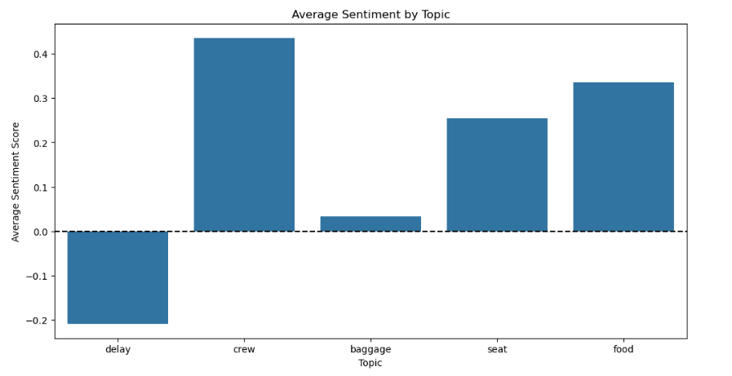
RESULTS
Key topics
Sentiment
According to the frequency chart, the most common topics in the reviews are "service," "seat," "crew," and "staff," suggesting that passengers often share feedback about their travel experience and the airline's employees.
Out of 1000 reviews, 741 were verified reviews of which 534 were positive, 442 were negative and 23 were neutral. This means the majority of reviews were
polarised as either positive or negative.
55%
Positive
43%
Negative
2%
Neutral

